Slide 1
How to Quantify the Security Level of Embedded Systems? A Taxonomy of Security Metrics
Ángel Longueira-Romero
Rosa Iglesias
David Gonzalez
Iñaki Garitano
Ángel Alfonso Antonio Longueira Romero
Notes:
Good morning everyone. Today, I will try to explain the research work that we have done and I will also show some of the results that we have achieved.
The title of the work is “How to quantify the security level of embedded system? A taxonomy of security metrics”

Slide 2




This is me
Hello!
I am Ángel
I am currently working on my PhD at IKERLAN in the Cybersecurity Embedded Systems Team
alongueira@Ikerlan.es
Ángel Longueira Romero
Notes:
But first things first, my name is Ángel, and I am currently working on my PhD Thesis about Cybersecurity. We are going to talk about Cybersecurity Evaluation for Embedded Systems, and more precisely, about security metrics.

Slide 3
1. Introduction
2. Previous work
3. Contribution
4. Conclusions and future work
Notes:
Here, you can see the table of contents of the presentation.
First, I will introduce the problem that we want to solve and I will give a little bit of context.
Second, we will talk about the Previous Work done.
Then, we will comment the contributions that we have done,
and finally, the conclusions that we have extracted and the future work.

Slide 4

1
Introduction
IKERLAN.
WHERE TECHNOLOGY IS AN ATTITUDE
Notes:
So, let’s start giving some context and explaining the problem that we want to solve.

Slide 5









Introduction
They are the driving force of the industry today
MANUFACTURING
TRANSPORTATION
ENERGY
They must be protected
TELECOMMUNICATIONS
HEALTHCARE
DEFENCE
EMBEDDED SYSTEMS
They perform all kinds of critical operations
CRITICAL INFORMATION AND SERVICES
GROWING IN NUMBER
CONNECTED
How can we know if an ES is secure enough?
There is an increasing number of security threats over ES
Notes:
Today, embedded systems have become the driving force behind technological development, with a strong presence in sectors such as:
Manufacturing.
Transportation.
Energy.
Telecommunications.
Healthcare.
Defence.
Proving to be a key piece in the industry, whose importance is growing. They are everywhere, and not only that…
Control critical processes and information.
They are growing in number.
They are also connecting to each other and to the Internet.
Under this scenario, there is an increasing number of security threats over Embedded Systems, but in ES development, security is not a priority in most cases.

Slide 6

Introduction
Do countermeasures work properly?
Is their coverage enough to undermine threats?
Are they correctly implemented?
Notes:
As I said before, there is an increasing number of security threats over ES, and countermeasures are being applied to protect them against known threats. As such, there are some questions that arise and cannot be answered yet:
Do counter measures work properly?
Is their coverage enough to undermine threats?
And, are they correctly implemented?

Slide 7




Introduction
Standardized
INPUTS
OUTPUTS
Guidance
Common reporting forms
Device
using
METRICS
Show progress
Design
EVALUATION
METHODOLOGY
Comparable results
Source Code
White-box / Black-box testing
Structured procedure
Oriented to ES
Notes:
In this situation, a standardized and general accepted security testing methodology is needed to provide guidance, confidence, structured procedures, common reporting forms, and the possibility to compare results along the time and among different systems.
These last factors can be achieved by introducing security metrics into the evaluation or assessment process.

Slide 8
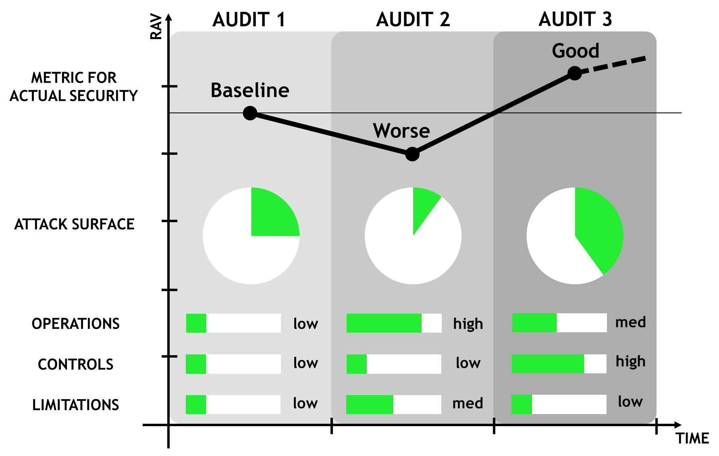



Introduction
METRICS
QUANTITATIVE
REPRODUCIBLE
REPEATABLE
SECURITY LEVEL
COMPARABLE
Notes:
Furthermore, if carefully designed and chosen, metrics would provide a quantitative, repeatable and reproducible value that would reflect the level of security protection of the ES.
These metrics can shed some light on measuring the degree of confidence in the effectiveness of the implementation of security measures in an ES. Metrics would allow the comparison of different evaluations of the same device over time, and even evaluations of different versions or devices.
When we say, “same device”, we mean same hardware, same software, and same versions of both.

Slide 9
Quote
When you can measure what you are speaking about, and express it in numbers, you know something about it.
-Lord Kelvin
“
Notes:
Our approach is really well expressed with this quote from Lord Kelvin:
When you can measure what you are speaking about, and express it in numbers, you know something about it.
This is a fancy way to say that we aim to use security metrics as a key piece to assess the security level of ES.

Slide 10

2
Previous Work
IKERLAN.
WHERE TECHNOLOGY IS AN ATTITUDE
Notes:
Now, we are going to explain the previous work done.

Slide 11



Previous Work
Metrics in the standards
Current issues of security metrics
LITERATURE
Properties of metrics
Metrics analysis
Taxonomies for metrics
Notes:
The research work that we have done can be classified into five main topics, and now, we are going to take a quick look to each one of them.

Slide 12
Previous Work
IEC 62443: conformance metrics for managing a security program throughout the life cycle of an industrial automation control system.
Common Criteria: defines the Evaluation Assurance Levels (EALs) as an increasing scale. The highest levels mean that more testing was done, but not necessarily that the product is more secure.
NIST: nine security metrics for three different aspects. Address security at the organization level.
OSSTMM: scale measurement of the attack surface.
Metrics in the standards
Current issues of security metrics
LITERATURE
Properties of metrics
Metrics analysis
Taxonomies for metrics
Notes:
We analysed the main security standards, to check whether they proposed any kind of security metric.
IEC 62443: proposed conformance metrics for managing a security program throughout the life cycle of an industrial automation control system.
Common Criteria: defines the Evaluation Assurance Levels (EALs) as an increasing scale. The highest levels mean that more testing was done, but not necessarily that the product is more secure.
NIST: defines nine security metrics for three different aspects, but it addresses security at the organization level.
OSSTMM: scale measurement of the attack surface.
Although there are a lot of approaches proposed in the standards, most of them address security at a very high level, so they can’t be applied to ES.

Slide 13
Previous Work
Lack of a solid theoretical foundation in support of the claimed correlation.
Lack of the scale, unit and reference values for comparing and interpreting results.
Lack of available implementations.
Lack of benchmarks for comparison.
Lack of widely accepted solutions.
It is difficult to understand whether they are applicable in a given context, and how to use them
Metrics in the standards
Current issues of security metrics
LITERATURE
Properties of metrics
Metrics analysis
Taxonomies for metrics
Notes:
We have also checked for the main issues of security metrics, and we found that there is:
Lack of a solid theoretical foundation in support of the claimed correlation.
The proposed metrics don’t proposed any kind of scale, unit or reference values for comparing and interpreting results.
Lack of available implementations.
There is almost no benchmarks for comparison.
And there is no widely accepted solutions.
With all this problems, it is difficult to understand whether they are applicable in a given context, and how to use them.

Slide 14
Previous Work
Suitable metrics are needed to achieve a foundational science to guide system design and development.
Some authors have tried to characterize which criteria should meet a good metric.
“SMART” (Specific, Measurable, Attainable, Repeatable, Time-dependent) criteria.
“PRAGMATIC” (Predictive, Relevant, Actionable, Genuine, Meaningful, Accurate, Timely, Independent, Cheap) criteria.
The characteristics identified in the work carried out by Savola (correctness, measurability, meaningfulness).
Metrics in the standards
Current issues of security metrics
LITERATURE
Properties of metrics
Metrics analysis
https://embeddedsecuritymetrics.github.io
Taxonomies for metrics
Notes:
We have also reviewed the literature to find which are the properties that a good security metric should fulfil. And we found three main criteria:
The SMART criteria and the PRAGMATIC criteria, where each letter represents a different property that the developed metric should meet.
And the properties identified by Savola, carrying out expert surveys. He interviewed 141 security experts from 21 different countries, and extracting 19 quality criteri. Savola identified correctness, measurability, and meaningfulness as the main quality criteria along with usability. Support human decision-making in every step of the life cycle.

Slide 15



Previous Work
There is neither a single system metric nor “one-perfect” set of metrics that could be suitable for every single case.
Analyze whether the existing metrics can be applied to ES.
Systematic review of the state of the art.
Currently available security metrics.
Metrics in the standards
Current issues of security metrics
LITERATURE
Properties of metrics
More than 500 metrics
Metrics analysis
150 metrics
20 metrics
Analysis
Selection
Testing
https://embeddedsecuritymetrics.github.io
Taxonomies for metrics
Notes:
On the other hand, we analysed the literature to find which metrics can be applied to ES. In order to do that, we did a systematic review of the literature, and we found more than 500 security metrics. After filtering them to discard all the security metrics that can not be applied to ES, we reduced the list to around 150 security metrics. And we plan to choose a smaller set of metrics, to apply them to evaluate its security level.

Slide 16
Previous Work
The most common classification for metrics divides them as Organizational, Technical, and Operational.
Taxonomies proposed in the literature are usually at a very high level (organization, network).
No taxonomy focuses on the specific assessment needs and limitations of ES.
Metrics in the standards
Current issues of security metrics
LITERATURE
Properties of metrics
Metrics analysis
Taxonomies for metrics
Notes:
Finally, we analysed the literature to find the most common taxonomies to classify security metrics. We found that the most common one divides them as follows:
Organizational (to describe and track how effectively organizational programs and processes achieve cybersecurity goals).
Technical (to describe and compare technical objects -e.g., algorithms, specifications and architectures- and to indicate the security level a specific system exhibits).
Operational (to describe and manage the risk to an operational environment, including used systems and operating practices).
We realized that the taxonomies proposed in the literature are designed at a very high level (usually, at organization or network level). So they can not be applied to classify metrics that asses the security level of an ES.

Slide 17

3
Contribution
IKERLAN.
WHERE TECHNOLOGY IS AN ATTITUDE
Notes:
After all this research work, we identified the gaps, and proposed some contributions to the state of the art.

Slide 18
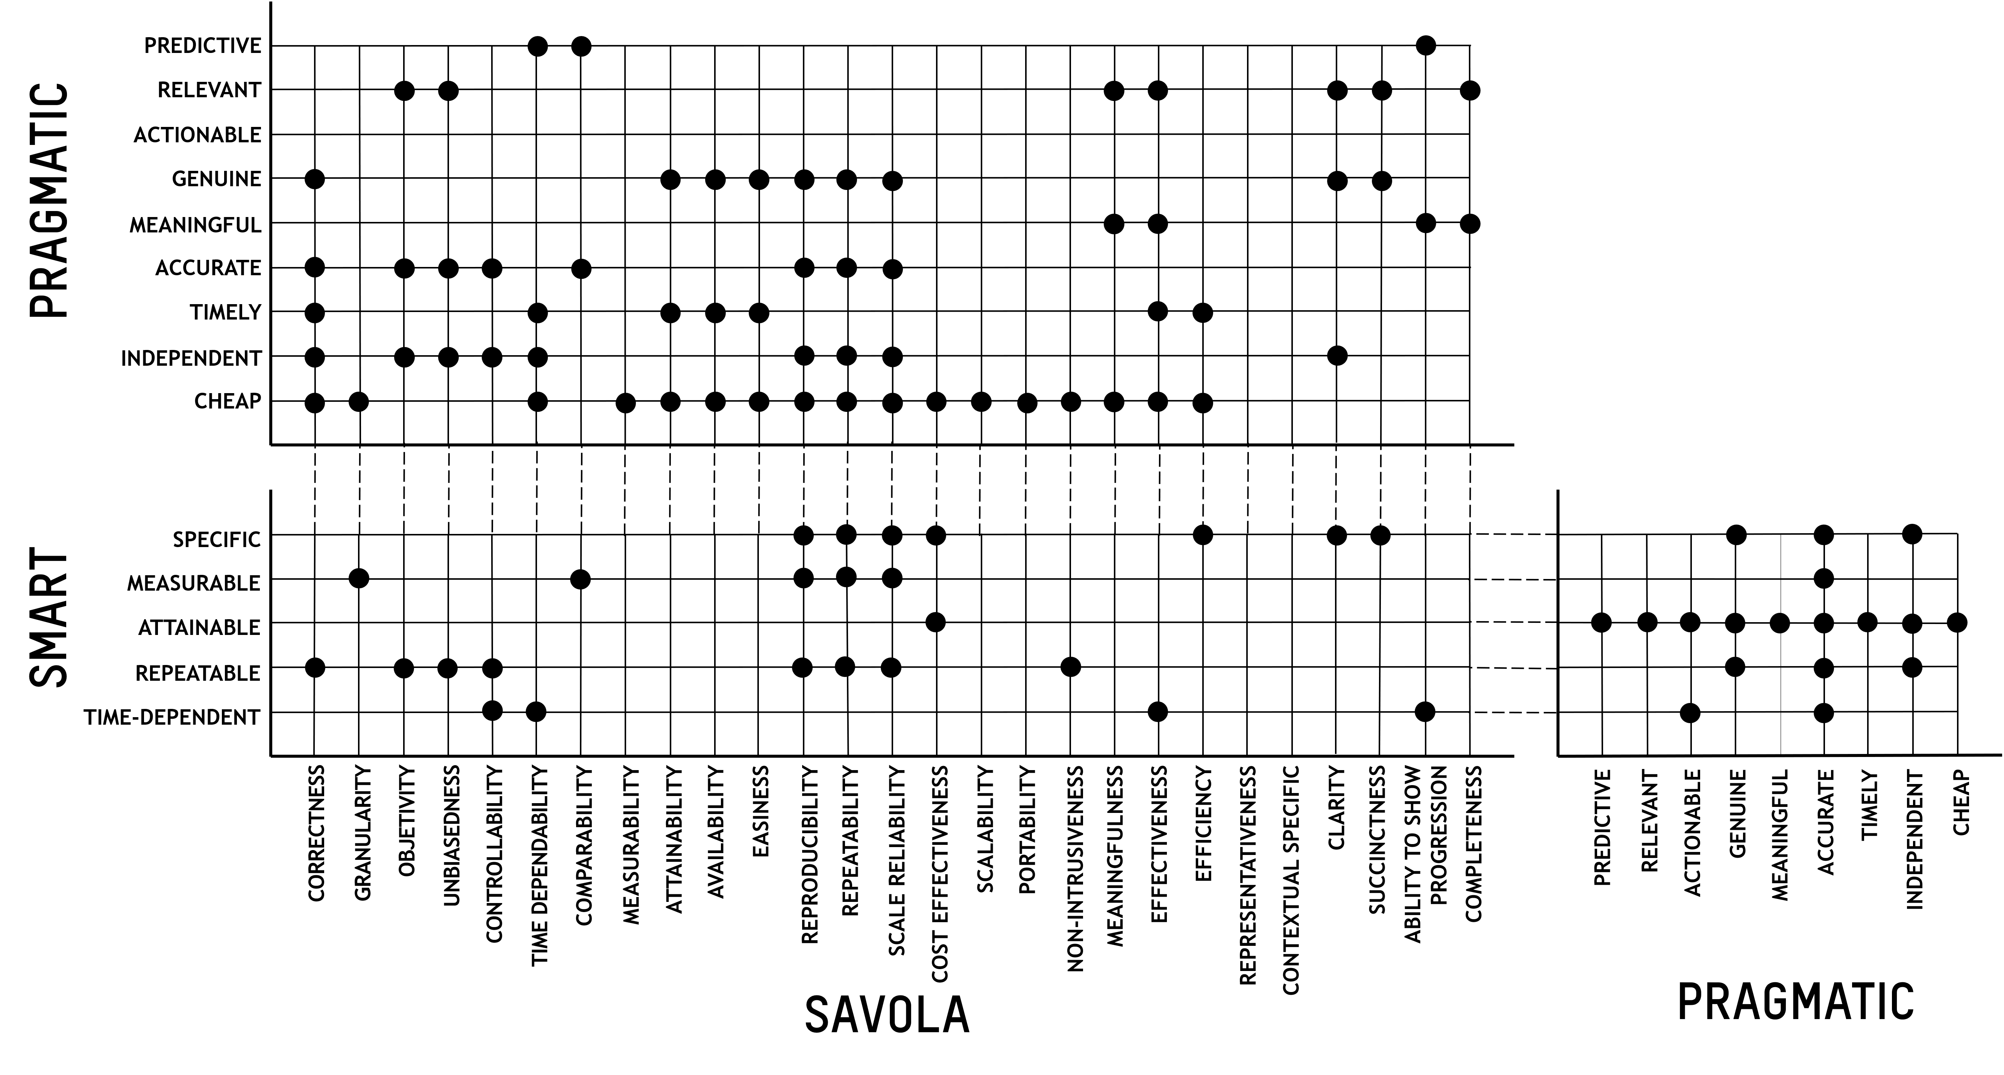
Properties of security metrics
Find the common points among them.
Identifying security metrics that show the degree of confidence in security effectiveness.
Notes:
The first contribution has to do with the properties that a good security metric should meet. We compared the three main criteria found in the literature to find the common points among them. A mapping was carried out using the definition and the data given by the authors.

Slide 19
Properties of security metrics
CORRECTNESS
IDENTIFIED BY SAVOLA
MEASURABILITY
Cost (develop and measure)
MEANINGFULNESS
SECURITY METRIC PROPERTIES
COMPARABILITY
COST EFFECTIVENESS
IDENTIFIED FOR ES
Desirable for metrics developed to evaluate ES
MEASURABILITY
REPEATABILITY
REPRODUCIBILITY
Notes:
Taking the previous mapping as a reference, we found that:
Correctness, measurability and meaningfulness, along with usability, are really common found to be desirable properties. Cost, as we expected, is also a relevant criterion to choose metrics. These were the properties proposed by Savola in his work.
The properties that we expect a metric to have are comparability, cost effectiveness, measurability, repeatability and reproducibility, as they are the most important ones in the ES context.

Slide 20

Security Metrics Analysis
SECURITY METRICS
77.5 % RELATED TO SOFTWARE
0.6 % RELATED TO HARDWARE
14.8 % RELATED TO BOTH
7.1 % RELATED TO OTHERS
GAP FOUND!
https://embeddedsecuritymetrics.github.io
Notes:
As far as the analysis of metrics is concerned, we classified them according to the asset of the ES that they evaluate, and we found that:
An interesting, albeit not very surprising fact, is that most of the metrics (77.5 % of them) were related exclusively to software - e.g., lines of code, number of functions and so on.
On the other hand, only 0.6 % of them were related exclusively to hardware - e.g., side-channel vulnerability factor metric;
and finally, 14.8 % of them could be applied to both software and hardware - e.g., the historically exploited vulnerability metric that measures the number of vulnerabilities exploited in the past.
The remaining 7.1 % is focused on other aspects, such as user usability.
This shows that there is a clear lack of hardware security metrics in the literature, and main efforts are centered in developing software-related metrics. It is worth commenting these metrics are not only valid for ES, but could also be applied to other systems.

Slide 21
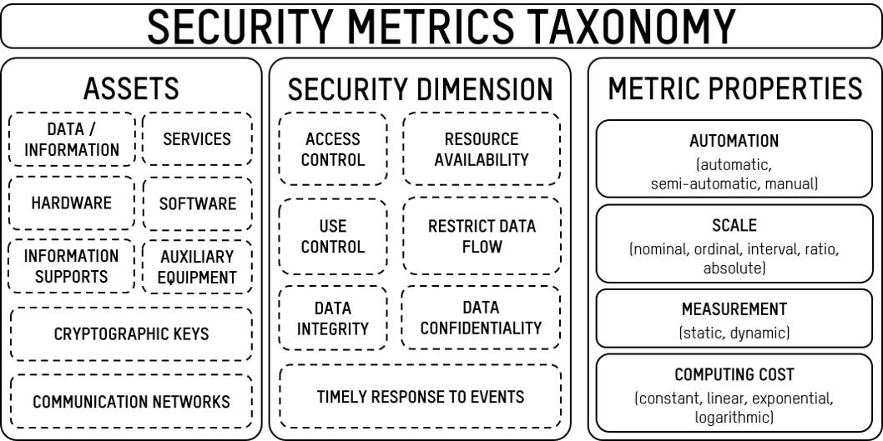
Taxonomy
Which attribute is to be protected (from IEC 62443)
Characteristic parameters
Elements of the ES that can be evaluated
Dashed line indicates AND/OR condition, and solid line AND condition.
Notes:
And finally, we proposed a new taxonomy for classifying security metrics. To the best of the authors knowledge, there is no taxonomy that focuses on the specific assessment needs and limitations of ES. Unlike other proposals in the literature that are at a high level, this one is specifically designed to evaluate all aspects that comprise ES:
Assets: elements of the ES that can be evaluated, as hardware, software, data, services, crypto keys, or communications;
Security Dimension: which attribute is to be protected (foundational requirements from the IEC 62443); and
Metric Properties: which are the characteristic parameters of the metric (such as automation, or computing cost).
It is important to notice that a metric might cover more than one asset, and/or more than one security dimension, but at least, one value for each one have to be assigned (dashed line in the figure). Nevertheless, all values in metric properties are needed for each metric, as they represent the way the metric behaves, the cost associated to a metric and the information it returns (solid line in the figure).

Slide 22
Taxonomy (example)
Assets: system hardware
Side-Channel Leakage (SCL)
Security dimension: data confidentiality
Automation: semi-automation
Scale: nominal (yes/no)
Metric properties
Measurement: dynamic
Computing cost: constant
This metric uses statistical tests to measure if a device is prone to a side channel attack by comparing two sets of data; a random one and a fixed one.
Notes:
Here, we can se an example of this taxonomy applied to the Side-Channel leakage (SCL) metric.

Slide 23

4
Conclusions & Future Work
IKERLAN.
WHERE TECHNOLOGY IS AN ATTITUDE
Notes:
Finally, and to finish the presentation, we will briefly comment the conclusions and the future work.

Slide 24


Conclusions and Future Work
CONCLUSIONS
FUTURE WORK
Security metrics are not standardized.
Taxonomy for security metrics.
Conceptual mapping of criteria for choosing most appropriate metrics.
169 security metrics have been identified (77.5 % SW, 0.6 % HW) applicable to ES.
Wider adoption of software-related security metrics.
A reduced set of metrics will be selected and applied to a real ES.
This will be the foundation for proposing a security assessment methodology specifically designed for ES.
Notes:
CONCLUSIONS
Security metrics are not standardized, and they would help in quantifying the security level of ES.
This research work proposes a new taxonomy for security metrics, which takes into account the different assets of ES.
A conceptual mapping of criteria for choosing most appropriate metrics is given.
The metrics that can be applied to ES have been identified.
And most of them are related to SW.
FUTURE WORK
A reduced set of metrics will be selected, refined, and applied to a real ES.
And we hope that this work will be the foundation for proposing a security assessment methodology specifically designed for ES, which will provide qualitative and quantitative results.

Slide 25
THANK YOU
alongueira@Ikerlan.es
Ángel Longueira Romero
Notes:
Thank you very much for your attention.

